Slide 1

Synchrony
Jacob Alspaw, Alex Hemm, Owen Helmstetter, Ted Timbrell, Bobby Wagner

Slide 2
What is it?
Synchrony (noun)
syn·chro·ny
state in which things happen, move, or exist at the same time
synchronized streaming service aiming to make the music listening experience social again by enabling users to choose songs to listen to and talk about together

Slide 3
Motivation
Radio was/is a social experience
Collaborative listening missing from key services
Use cases not covered by existing products
Listen as a group in public (without being rude)
People spend more money on headphones than speakers
Phone speakers are pretty bad
Connect and share with friends and family over long distances
Synchronization of speakers in different rooms

Slide 4
Features

Slide 5
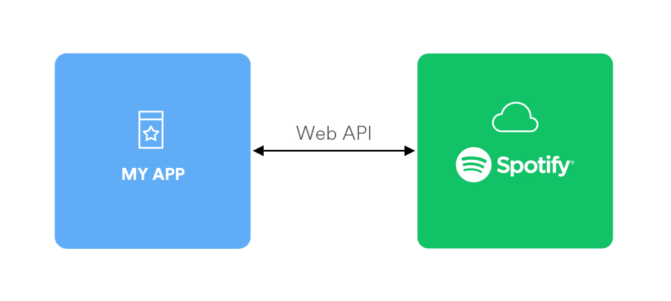
Core Features
Lobbies
Guest create and host lobbies
Join lobbies with lobby ID
Streaming
Delivers synchronized audio
Uses spotify API as source audio
Real Time Communications
Text chat
Chat lists song metadata
Notes:
Alex

Slide 6


Stretch Features
Native (Mobile) support
Song voting system
Additional music sources
Switching between audio sources
Guest access control for queue
Additional chat room features
Voice communications
Text chat support: Rich links, formatted text, emojis
Lobby commands
Notes:
Alex

Slide 7
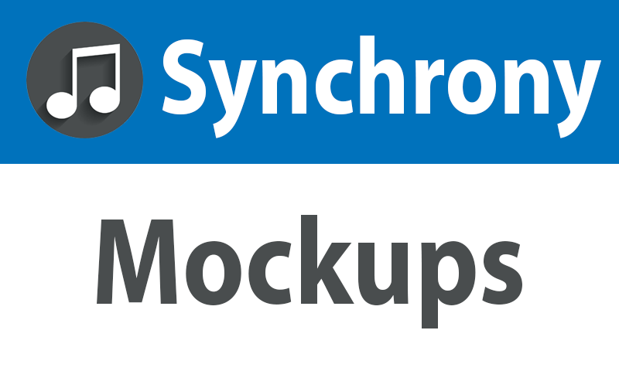

Slide 8
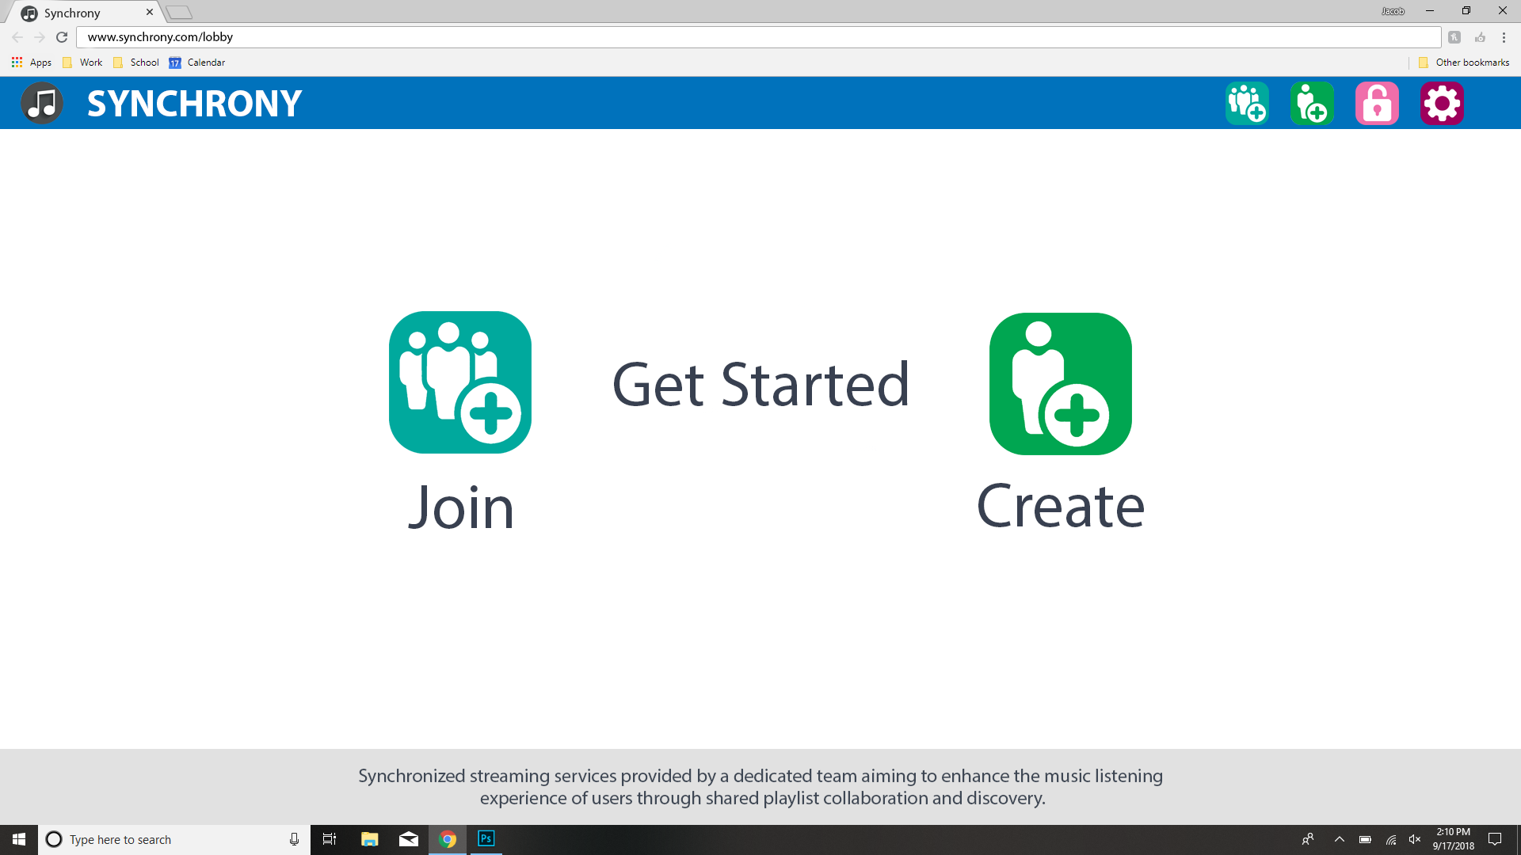

Slide 9
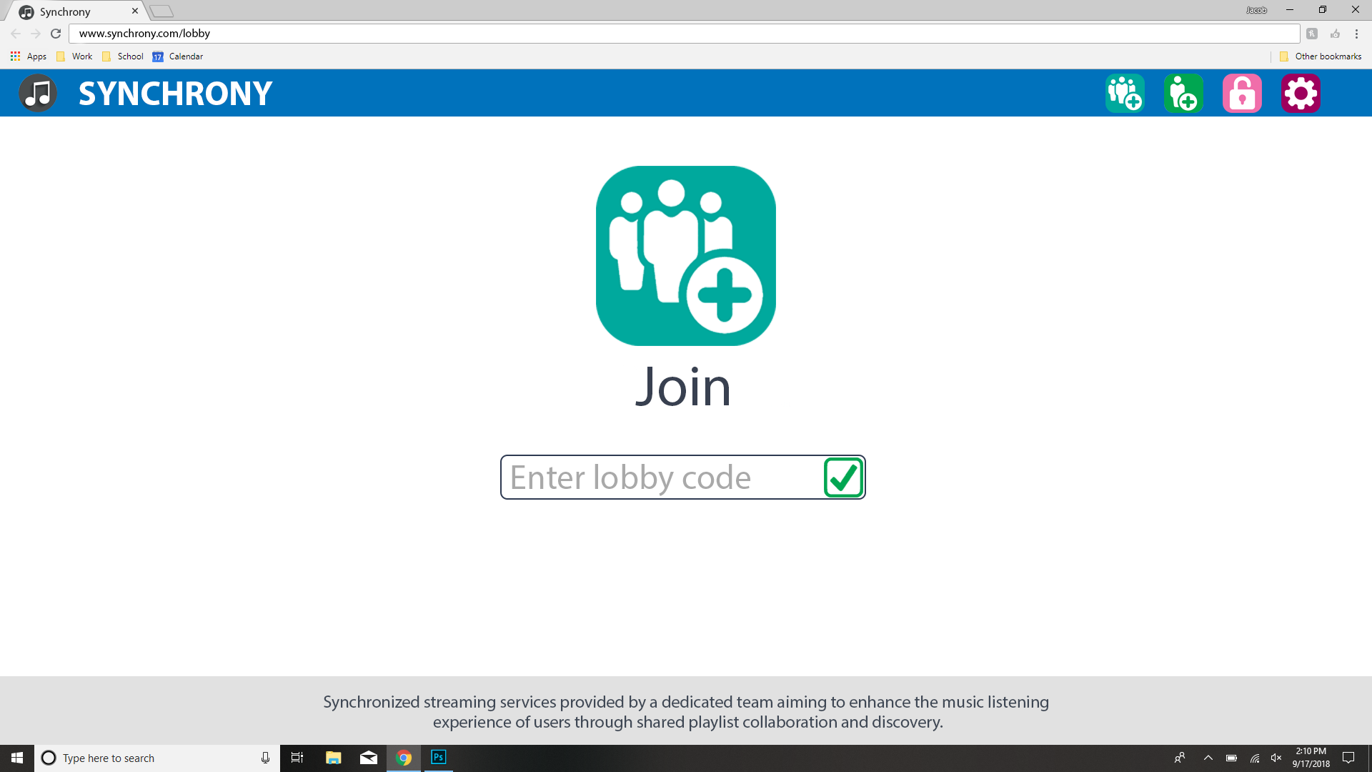

Slide 10
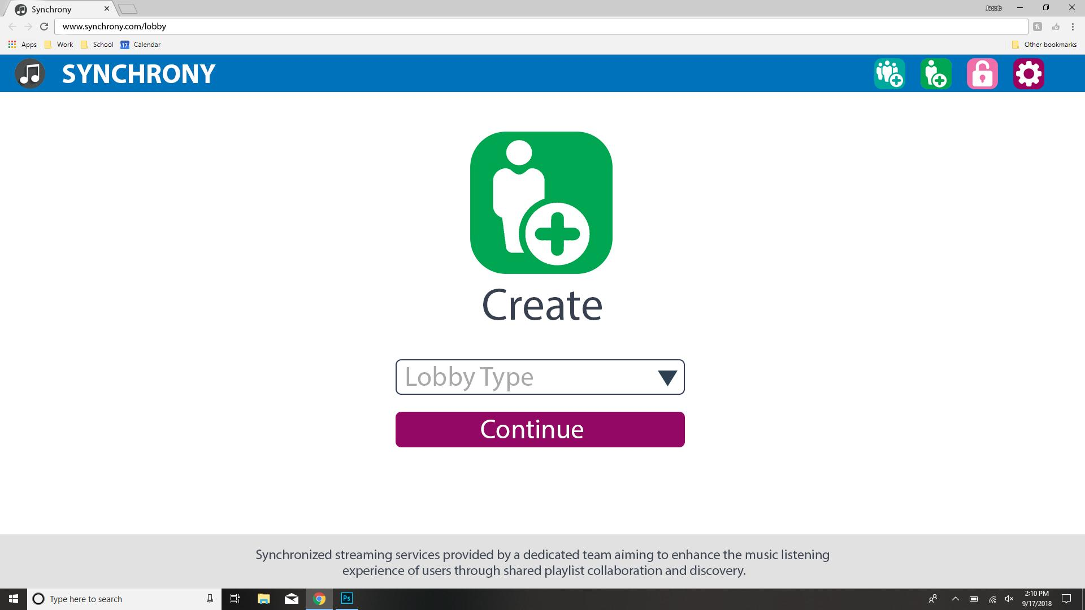

Slide 11
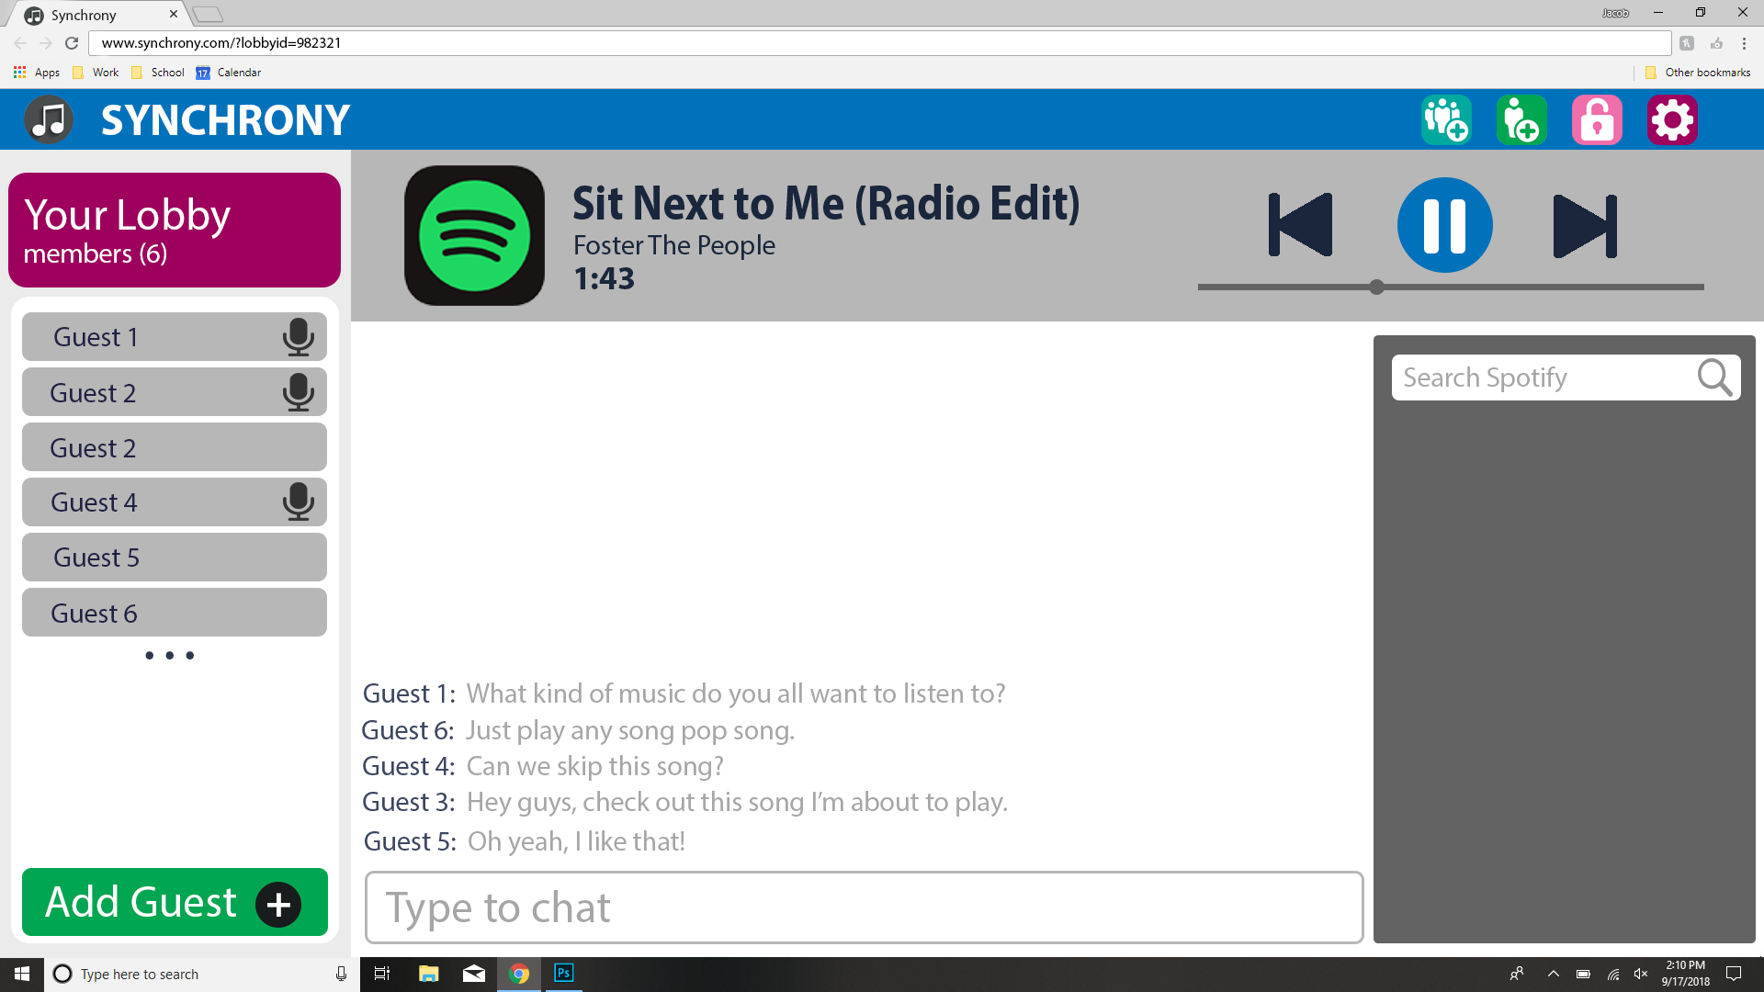

Slide 12
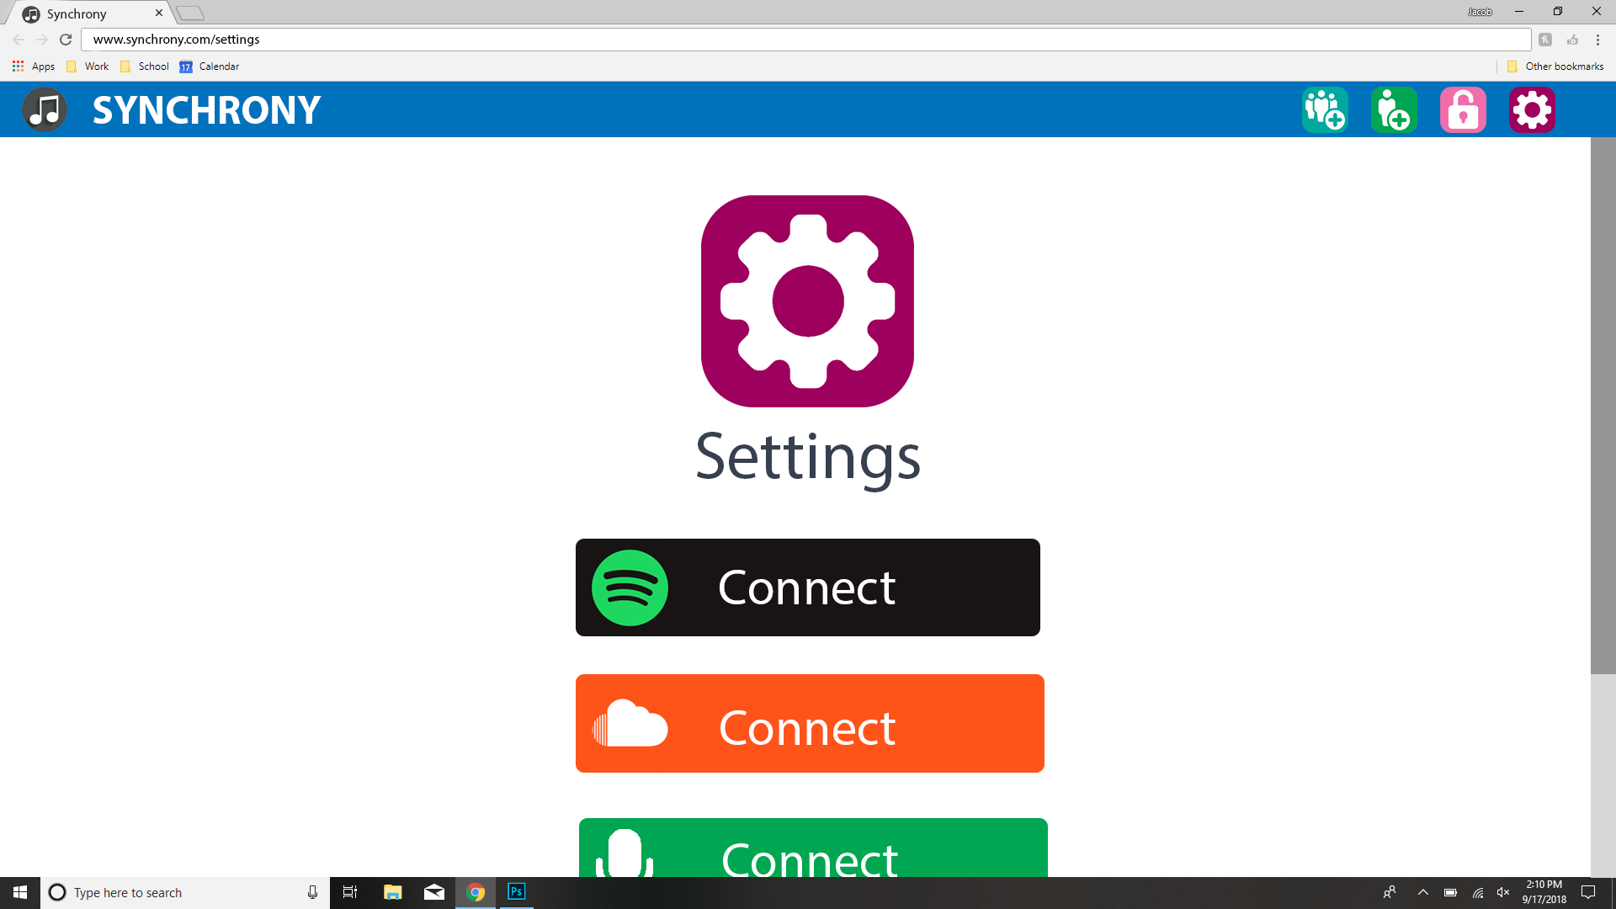

Slide 13
High Level Design

Slide 14
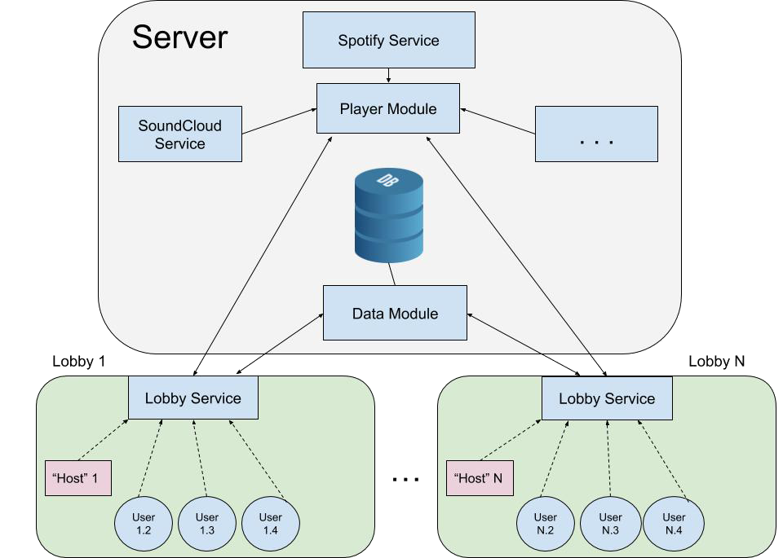
Architecture
Client-server model
Hosts and guests
Extensibility and loose coupling
Notes:
Bobby
https://en.wikipedia.org/wiki/Extensibility

Slide 15
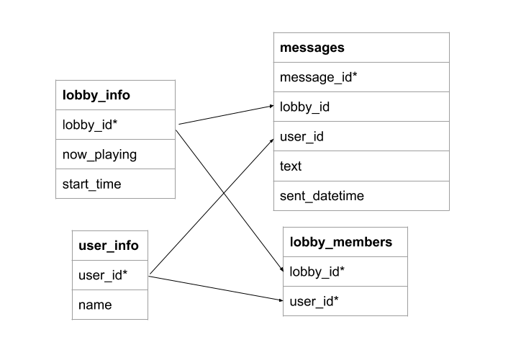
Database Design
PostgreSQL
Object relational design
Notes:
Bobby

Slide 16
Languages, Testing and Documentation
Notes:
owen

Slide 17


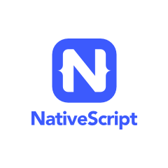

Languages and Tooling
Back-end
Django
PostgreSQL
Front-end
Angular 6
NativeScript

Slide 18
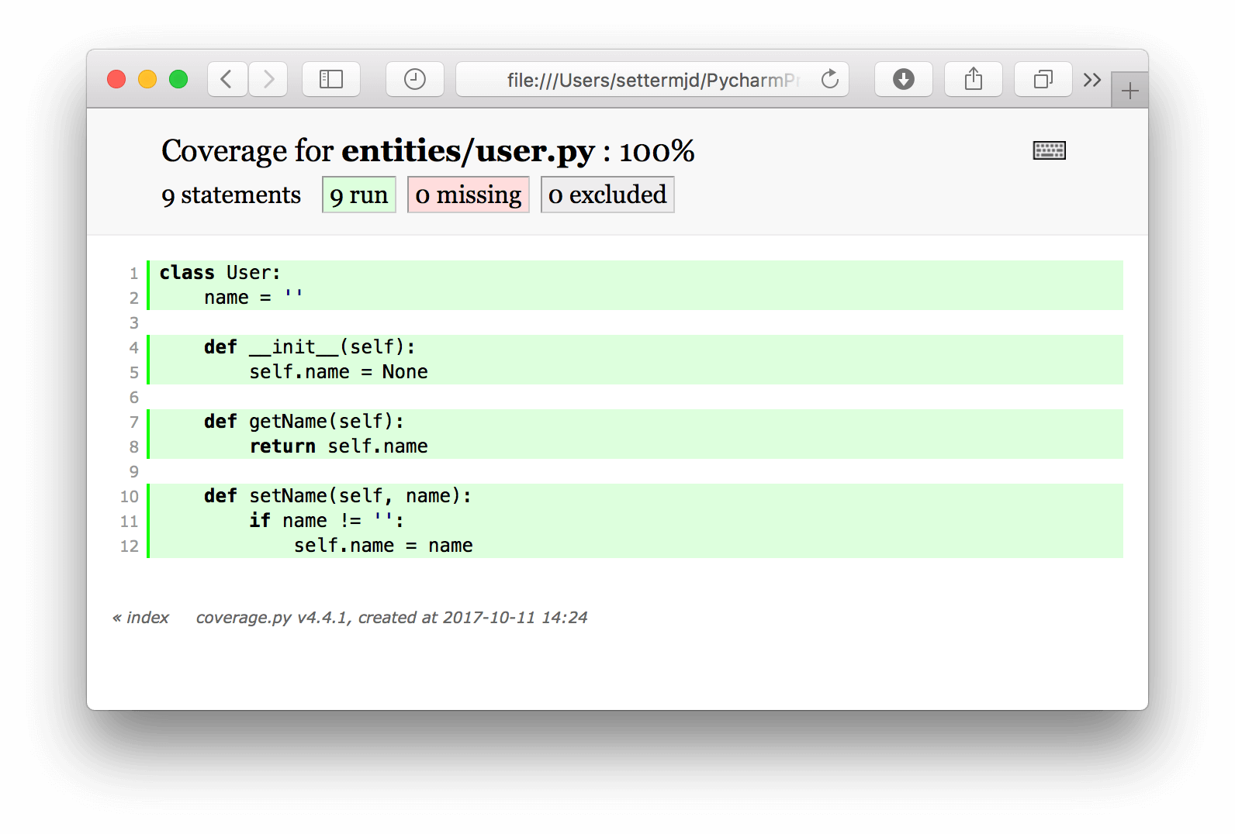

Testing
Django (Back-end)
unittest
coverage.py
Angular (Front-end)
Jasmine test framework
Karma test runner
--code-coverage
Notes:
Using the Angular CLI for testing means that any time a change to the code is saved our tests will automatically start to run in the background.

Slide 19

Documentation
Admindocs (Django)
Backend comments are written with docstrings in the code
Compiled to a webpage
Compodoc (Angular)
Reads JSDoc style comments in the code
Creates Angular-specific documentation as a web page

Slide 20
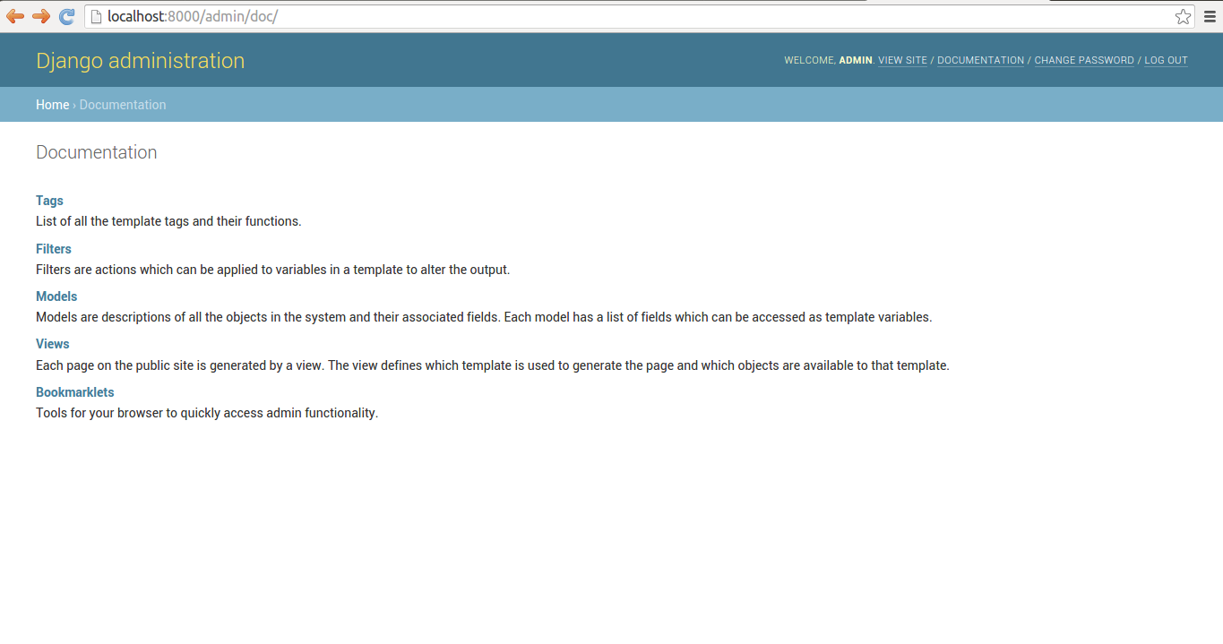

Slide 21
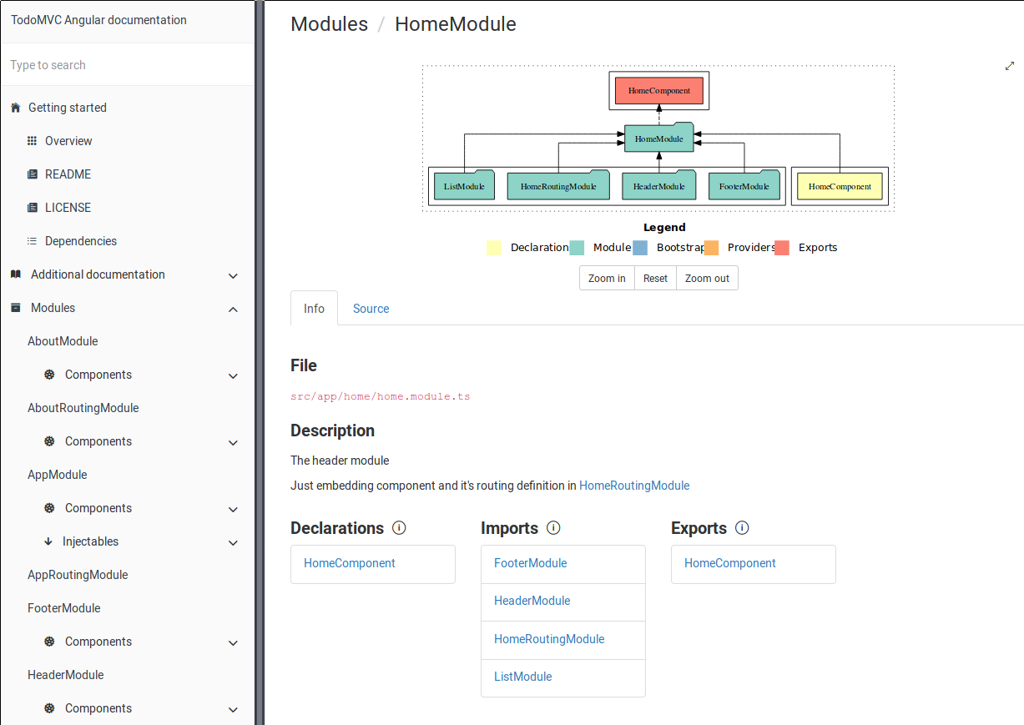

Slide 22
Task Breakdown and Planning

Slide 23
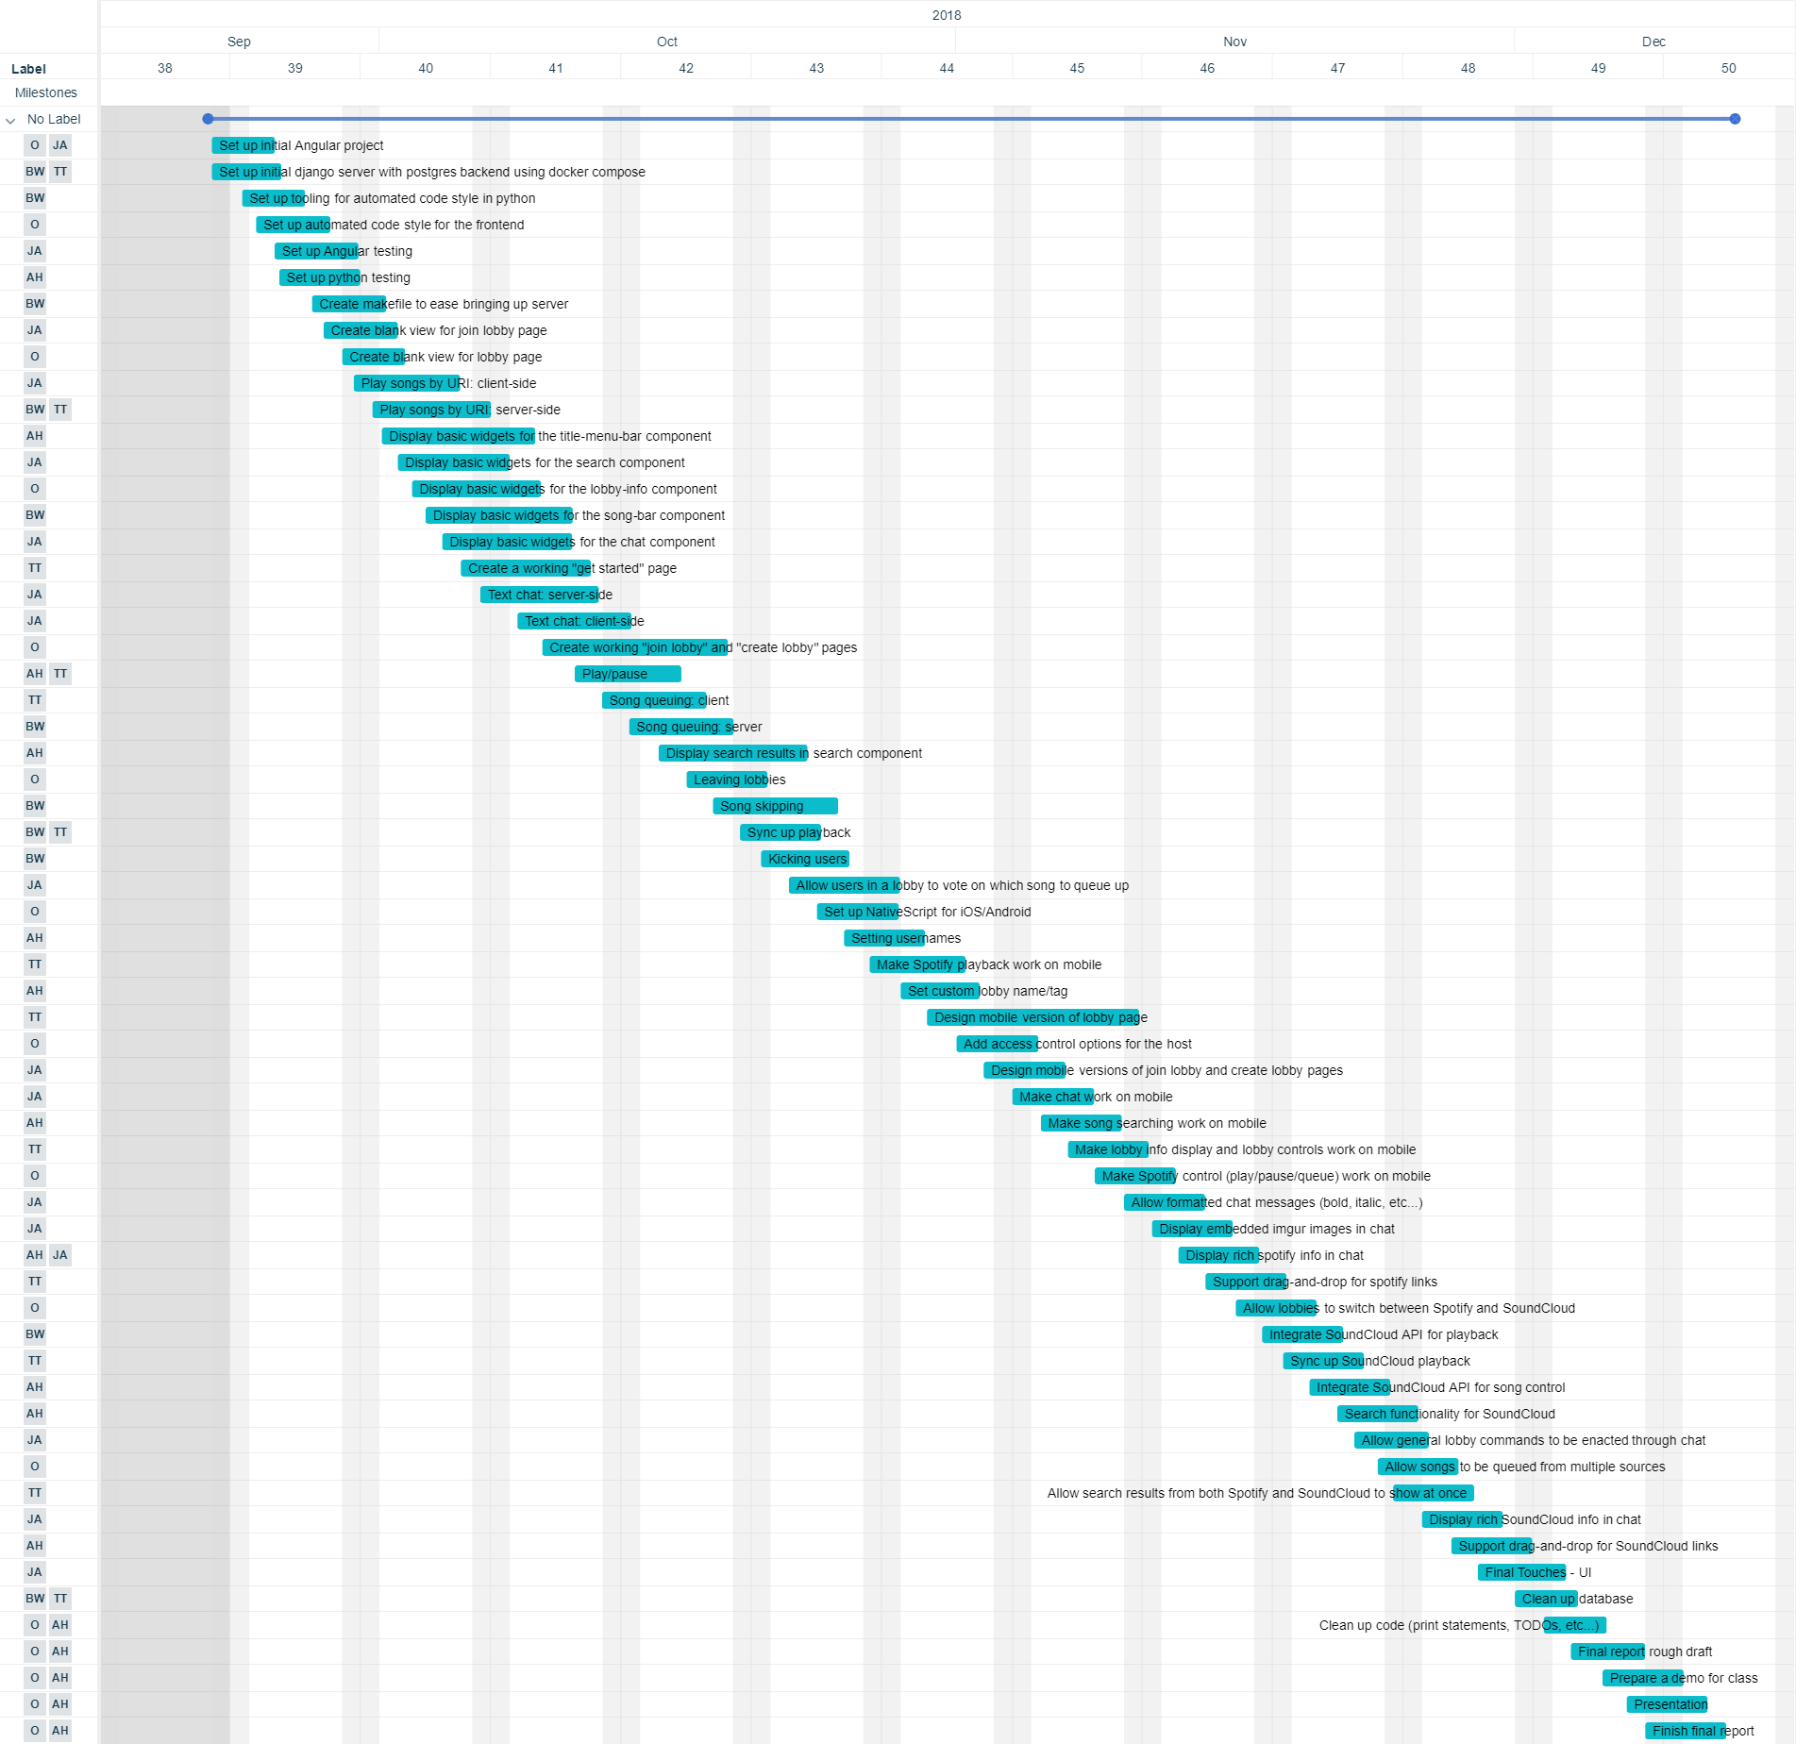
Notes:
We’re using Trello for project management and issue tracking
Get MVP done by November
Write tests during development

Slide 24
Allocation of Work
Owen
Experienced with Angular
Will be heading up our front-end development
Alex
Experienced with Web Design
Exposed to MVC frameworks
Focusing on the front-end
Jacob
Well versed in Web Development
Focusing on developing our real-time communications
Ted
Fluent in Python and Javascript
Will be assisting with the back-end and working on synchronization
Bobby
Experienced with Django and Python
Used Django, Pyramid, XGBoost and Spark at scale
Will prioritize setting up our back-end services

Slide 25
Questions?

